Slide 1

A Generic Stack
PHP
Backend Language
Apache
Web Server
MySQL
Database
XAMPP (APP)
HTML
CSS
JS

Slide 2
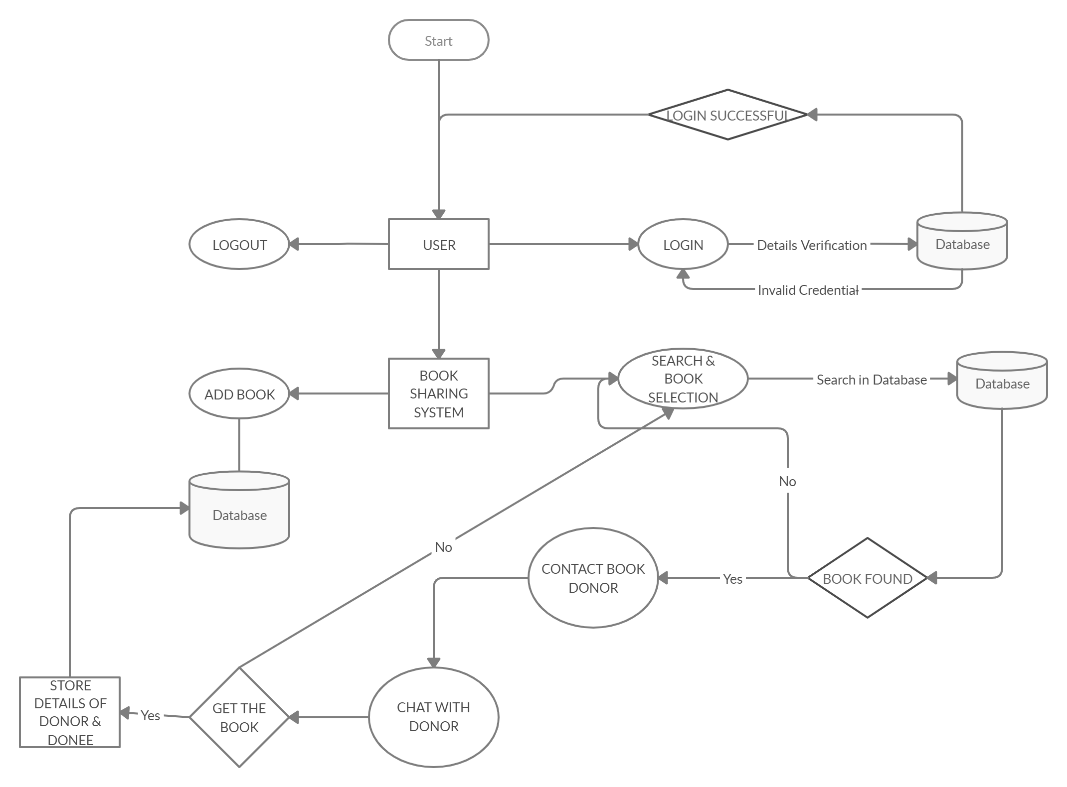
Work Flow Diagram

Slide 3
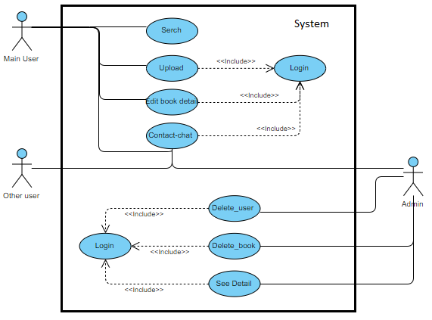
Use Case Diagram

Slide 4
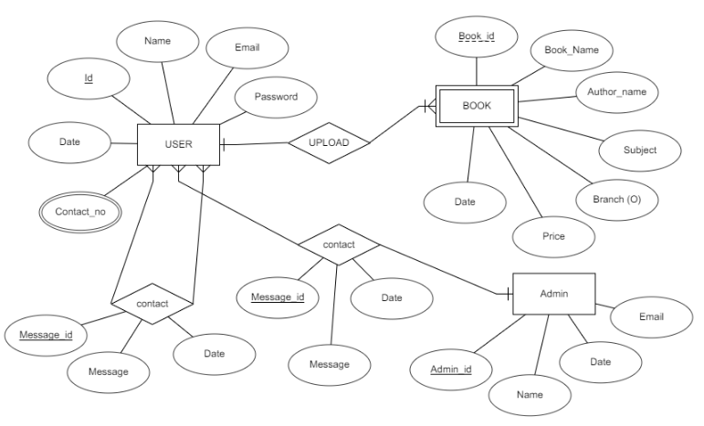
ER Diagram

